Slide 1
Introduction to SOLID Principles
SOLID principles are a set of five design principles that aim to make software designs more understandable, flexible, and maintainable.

Slide 2
Single Responsibility Principle (SRP)
A class should have only one reason to change, meaning that a class should have only one job or responsibility.

Slide 3
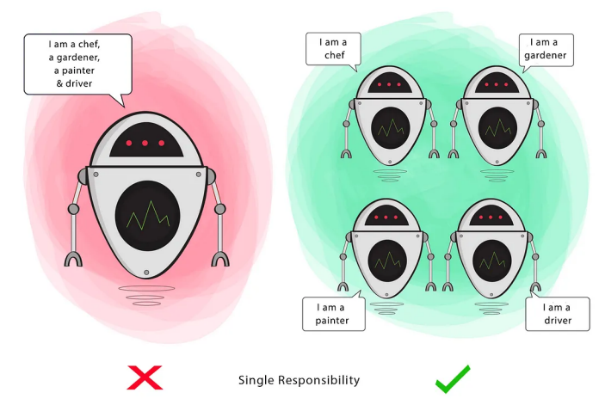
Principle
A class should do one thing and therefore it should have only a single reason to change.
A module should have one, and only one, reason to change

Slide 4
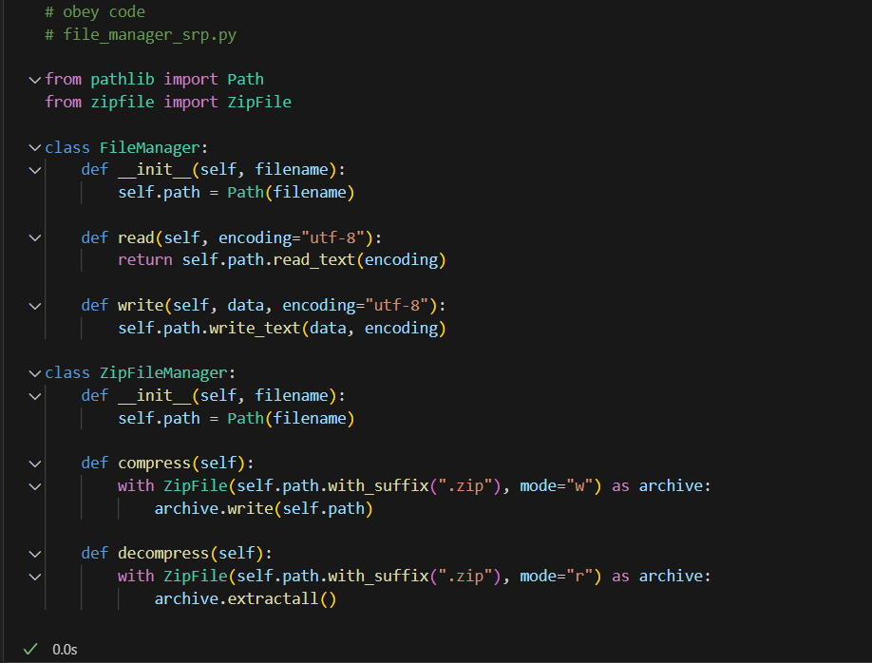
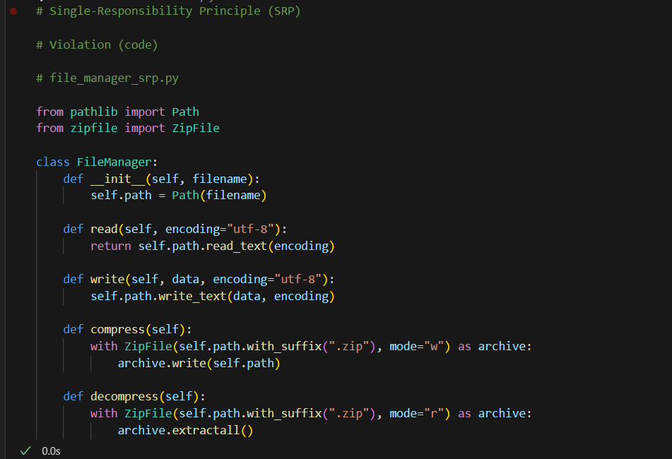

Slide 5
Open/Closed Principle (OCP)
Software entities (classes, modules, functions, etc.) should be open for extension but closed for modification.

Slide 6
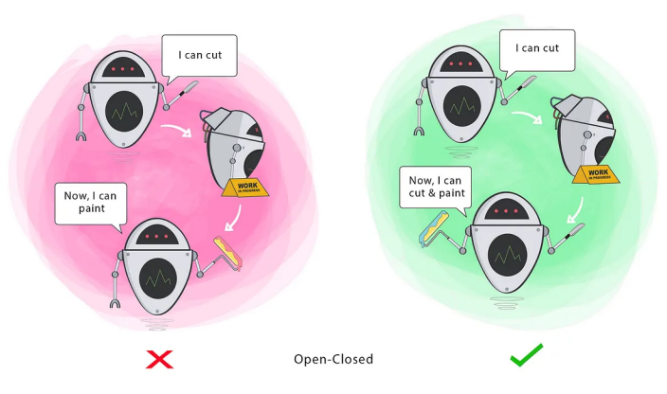
Principle
You should be able to extend a module’s behaviour, without modifying it
We should be able to add new functionality without touching the existing code for the class. This is because whenever we modify the existing code, we are taking the risk of creating potential bugs. So we should avoid touching the tested and reliable (mostly) production code if possible.
Note: this is not a single class
It is a module

Slide 7
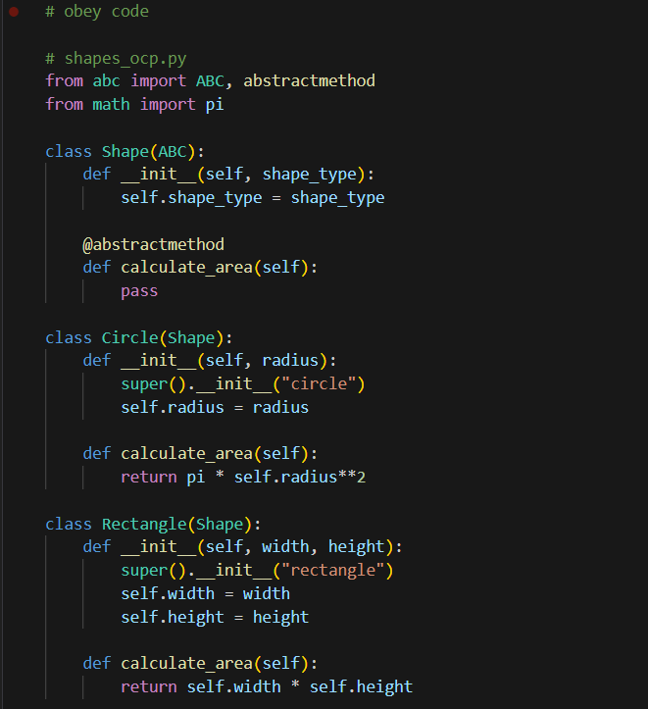
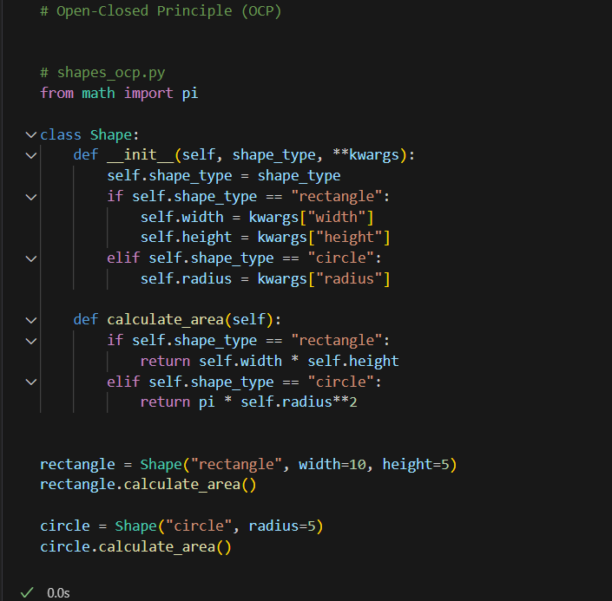
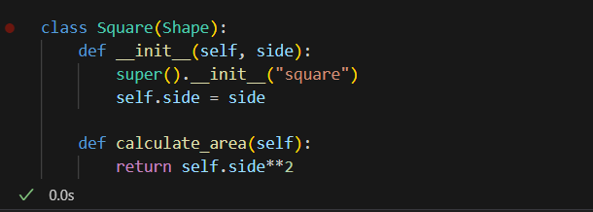

Slide 8
Liskov Substitution Principle (LSP)
Subtypes must be substitutable for their base types without altering the correctness of the program.

Slide 9
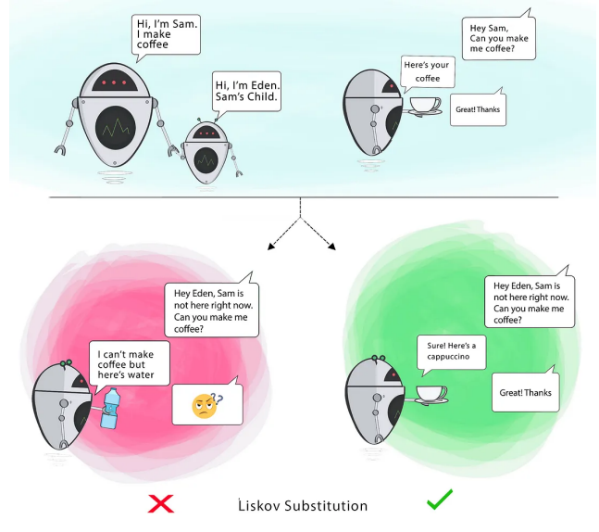
Principle
This means that, given that class B is a subclass of class A, we should be able to pass an object of class B to any method that expects an object of class A and the method should not give any weird output in that case.
Liskov's principle is easy to understand but hard to detect in code.
This principles confirms that our abstraction is correct and helps us get a code that is easy reusable, and class hierarchies that are easily understood. This principle LSP closely is related to OCP. The violation of LSP is actually violation of OCP in theory.

Slide 10
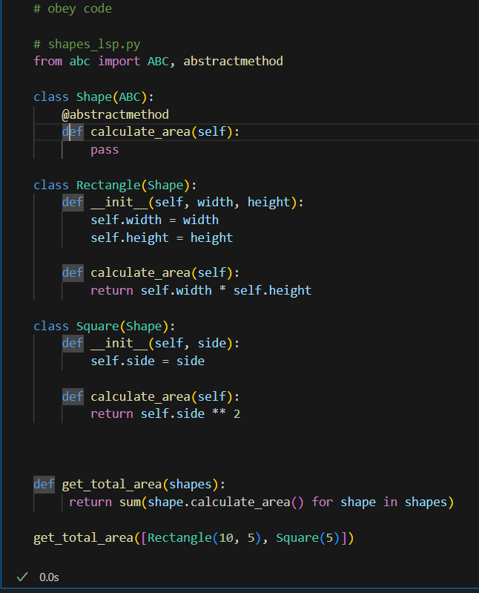
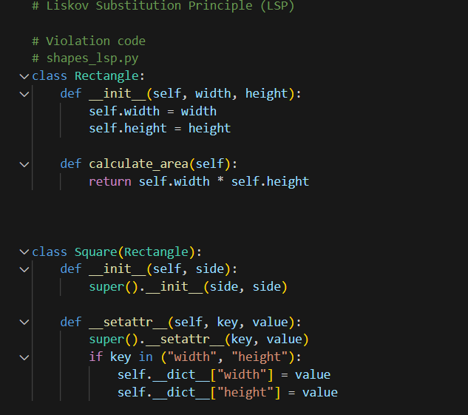
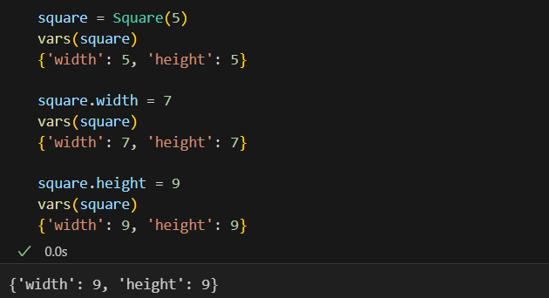

Slide 11
Interface Segregation Principle (ISP)
ISP: Clients should not be forced to depend on interfaces they don't use

Slide 12
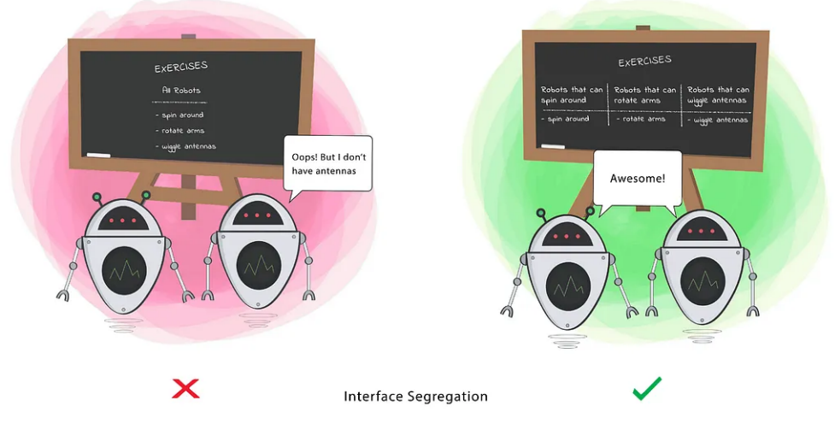
Principle
Segregation means keeping things separated, and the Interface Segregation Principle is about separating the interfaces.
Clients should not be forced to implement a function they do no need.
The interface of a program should be split in a way that the user/client would only have access to the necessary methods related to their needs.

Slide 13
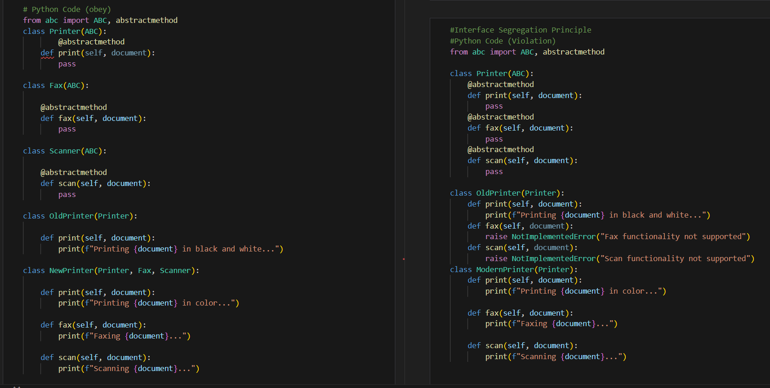

Slide 14
Dependency Inversion Principle (DIP)
High-level modules should not depend on low-level modules; both should depend on abstractions.

Slide 15
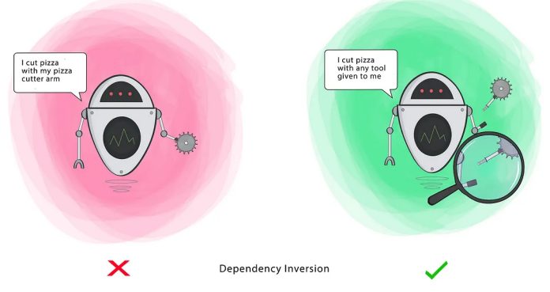
Principle
High-level modules should not depend on low-level modules.
Both should depend on abstractions. Abstractions should not depend upon details.
Details should depend upon abstractions
Notes:
High-Level object: Any object referencing another object (HAS-A relationship).
Low-Level object: The object that is being referenced. (HAS-A relationship in the reverse direction)
Abstractions: Abstract class or an Interface.
Details: Concrete implementations of the Abstractions.

Slide 16
